Slide 1


Fernando
21 Feb 2025

Slide 2

Outline
Executive Summary
Introduction
Methodology
Results
Conclusion
Appendix

Slide 3
Executive Summary
Summary of methodologies:
Data Collection API
Data Collection Web Scraping
Data Wrangling
Exploratory Data Analysis with SQL
Exploratory Data Analysis with Data Visualization
Exploratory Data Analysis with Folium
Machine Learning Prediction
Summary of all results:
Exploratory Data Analysis with SQL
Interactive Analytics Screenshots
Predictive Analytics Result

Slide 4
Introduction
Project background and context:
SpaceX offers Falcon 9 rocket launches at a cost of $62 million, significantly lower than other providers, whose costs exceed $165 million per launch. A major factor in these cost savings is SpaceX's ability to reuse the first stage of the rocket.
By accurately predicting whether the first stage will land successfully, we can estimate the overall cost-efficiency of a launch. This insight is valuable for other companies aiming to compete with SpaceX in the commercial space launch industry.
The objective of this project is to develop a machine learning pipeline that can predict the likelihood of a successful first-stage landing for Falcon 9.
Problems you want to find answers:
What factors influence the successful landing of a rocket's first stage?
Identifying key variables that contribute to a safe and stable landing.
How do different conditions and features interact to affect landing success rates?
Understanding the relationships between various technical and environmental parameters.
What operational conditions are necessary to maximize landing success?
Determining optimal launch and landing conditions for future missions.

Slide 5

Section 1

Slide 6
Methodology
Executive Summary
Data collection methodology:
Fetch data using SpaceX API
Web Scraping from Wikipedia
Perform data wrangling
Extract relevant features and resolve missing values
Perform exploratory data analysis (EDA) using visualization and SQL
Perform interactive visual analytics using Folium and Plotly Dash
Perform predictive analysis using classification models
Build, tune, evaluate classification models

Slide 7
Data Collection
Data Source:
1. SpaceX API:
Data was retrieved through HTTP requests to various SpaceX API endpoints, including:
/v4/launches/past – Initial launch data.
/v4/rockets, /v4/launchpads, /v4/payloads, /v4/cores – Additional details such as rocket specifications, launchpad locations, payload information, and core booster details.
2. Falcon 9 Wikipedia Page:
Additional historical launch records were extracted through web scraping using BeautifulSoup.
The launch data was retrieved from HTML tables, parsed, and transformed into a structured pandas DataFrame for further analysis.

Slide 8
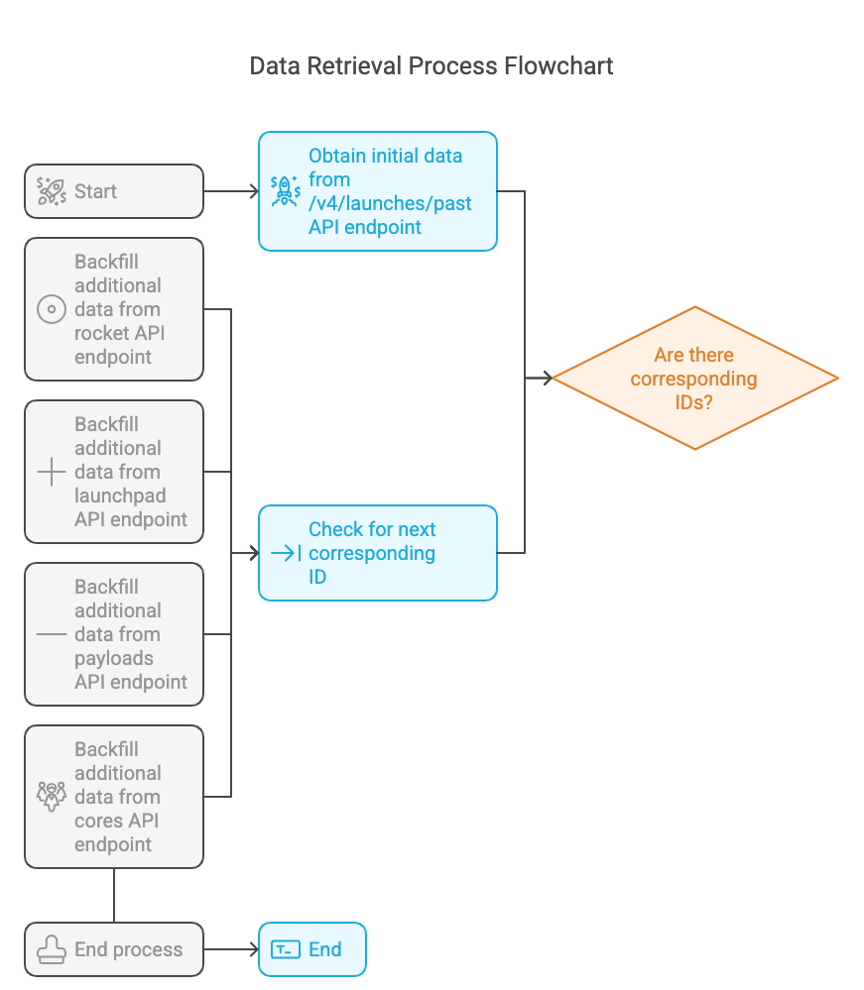
Data Collection – SpaceX API
Process:
The primary dataset was retrieved from the /v4/launches/past API endpoint.
Supplementary details were sourced from the rockets, launchpads, payloads, and cores endpoints to enrich records with corresponding IDs.
Notebook:
https://github.com/Fernando-Lim/data-science-capstone

Slide 9
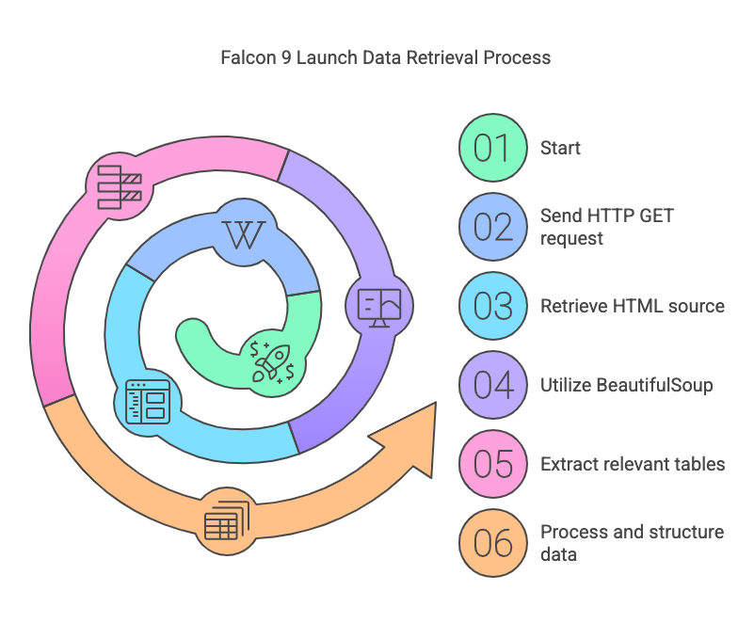
Data Collection - Scraping
Process:
Sent an HTTP GET request to the Falcon 9 launch page on Wikipedia to retrieve the HTML source.
Utilized BeautifulSoup to parse the HTML and extract relevant tables containing launch data.
Processed and structured the extracted data into a Pandas DataFrame for further analysis.
Notebook:
https://github.com/Fernando-Lim/data-science-capstone

Slide 10
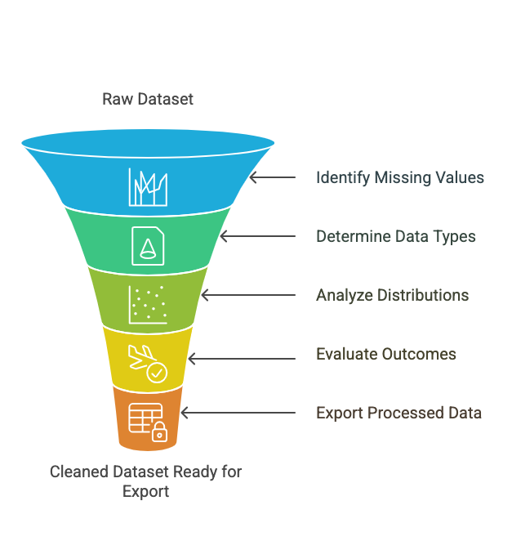
Data Wrangling
Process:
Performed Exploratory Data Analysis (EDA) to uncover patterns and insights within the dataset.
Identified and handled missing values by calculating their percentage for each attribute.
Determined data types by categorizing columns as numerical or categorical.
Analyzed launch distributions, including the number of launches per site and the frequency of different orbit types.
Examined landing outcomes, grouping them into binary categories (success or failure).
Created a "Class" label based on landing outcomes to serve as the target variable for training machine learning models.
Exported the cleaned and processed data to a CSV file for further analysis and modeling.
Notebook:
https://github.com/Fernando-Lim/data-science-capstone

Slide 11
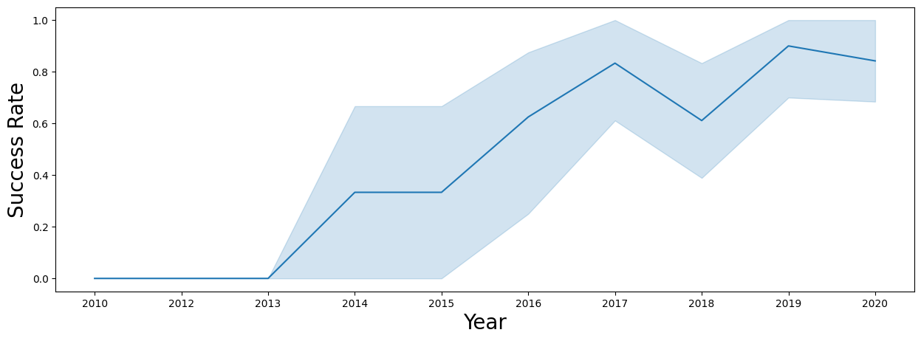
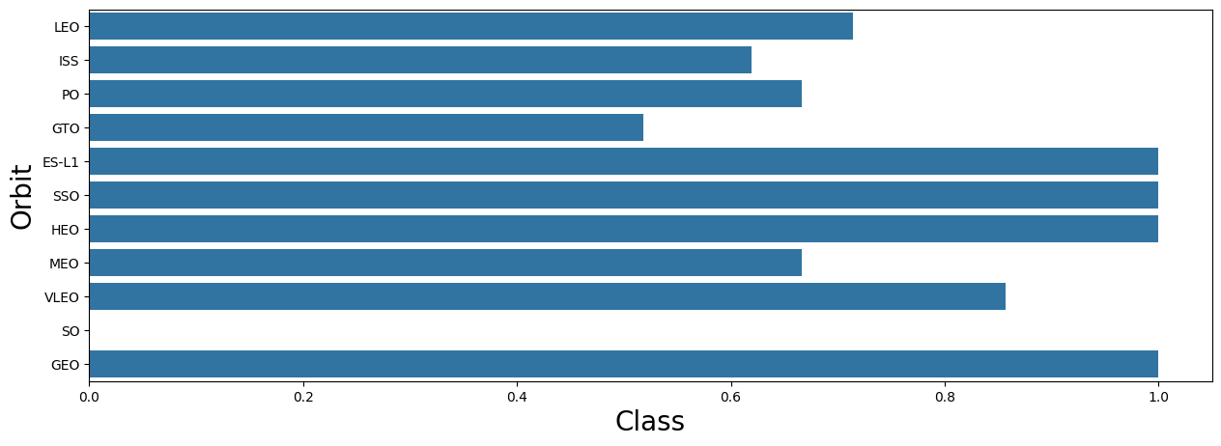
EDA with Data Visualization
Exploratory Data Analysis (EDA) Process:
Visualized key relationships to understand the impact of various factors on launch success.
Examined correlations between flight number and launch site, as well as payload and launch site.
Analyzed success rates across different orbit types.
Explored trends between flight number and orbit type to identify patterns.
Tracked yearly success rates to observe improvements over time.
Converted numerical columns to float64 for consistency in data processing.
Notebook:
https://github.com/Fernando-Lim/data-science-capstone

Slide 12
EDA with SQL
Loaded SpaceX Dataset into SQLite Database
Queries Performed:
Identify unique launch sites.
Retrieve 5 records where the launch site starts with 'CCA'.
Calculate total payload mass for boosters launched by 'NASA (CRS)'.
Find the average payload mass of Falcon 9 v1.1 boosters.
Get the date of the first successful ground landing.
List booster versions with successful drone ship landings for payloads between 4000-6000kg.
Count successful vs. failed mission outcomes.
Identify booster versions that carried the maximum payload.
Extract mission details (month, outcome, booster, launch site) for failed drone ship landings in 2015.
Show outcome distribution between June 4, 2010, and March 20, 2017.
Notebook:
https://github.com/Fernando-Lim/data-science-capstone

Slide 13
Build an Interactive Map with Folium
Various map objects to analyze geographical patterns in the launch data:
Markers: Plotted all launch sites to visualize their locations.
Color-Coded Markers: Indicated successful (green) and failed (red) launches to assess site performance.
Circles: Highlighted launch sites and their surrounding areas.
Lines: Measured distances between launch sites and key landmarks like railways, highways, and coastlines.
Reason for Adding These Objects:
To identify launch success trends by visually distinguishing successful vs. failed launches.
To explore geographic influences on launch sites, such as proximity to infrastructure and safety considerations.
To enhance data-driven decision-making by analyzing how location impacts launch outcomes.
Notebook:
https://github.com/Fernando-Lim/data-science-capstone

Slide 14
Build a Dashboard with Plotly Dash
Interactive Plotly Dash dashboard to enable data exploration, featuring:
Pie Chart:
When all sites are selected: Displays the distribution of successful launches across all sites.
When a specific site is selected: Shows the success vs. failure ratio for that site.
Scatter Plot:
When all sites are selected: Visualizes the relationship between payload mass, booster version, and launch outcomes across all sites.
When a site is selected: Filters the scatter plot to show data for only that site.
Payload Mass Range Selector: Allows users to filter the scatter plot based on payload mass.
Reason for Adding These Plots and Interactions:
Pie Chart helps compare overall launch success rates across different sites.
Scatter Plot provides insights into how payload mass and booster versions impact launch success.
Interactive Filters allow for dynamic data exploration, making it easier to identify trends and correlations.
Notebook:
https://github.com/Fernando-Lim/data-science-capstone

Slide 15
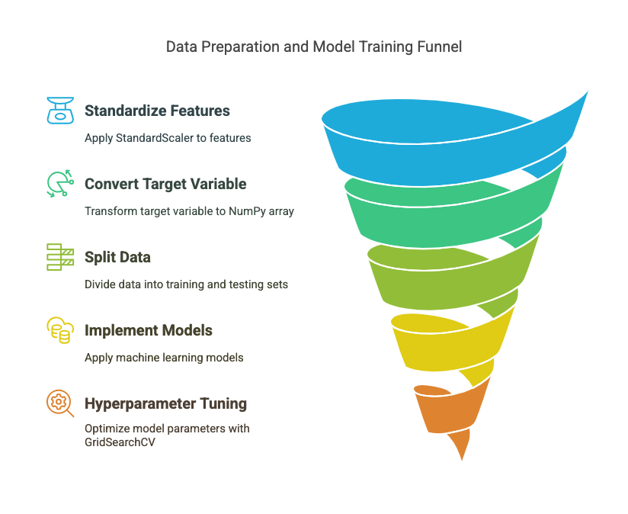
Predictive Analysis (Classification)
Data Preparation:
Loaded the dataset and applied StandardScaler to standardize features.
Converted target variable Y into a NumPy array.
Split the data into training and testing sets for model evaluation.
Model Training & Evaluation:
Implemented multiple machine learning models:
Logistic Regression
Support Vector Classifier (SVC)
Decision Tree Classifier
K-Nearest Neighbors (KNN)
Used GridSearchCV to test different hyperparameter combinations and identify the best-performing model.
Notebook:
https://github.com/Fernando-Lim/data-science-capstone

Slide 16
Results
Exploratory data analysis results
Interactive analytics demo in screenshots
Predictive analysis results

Slide 17

Section 2

Slide 18
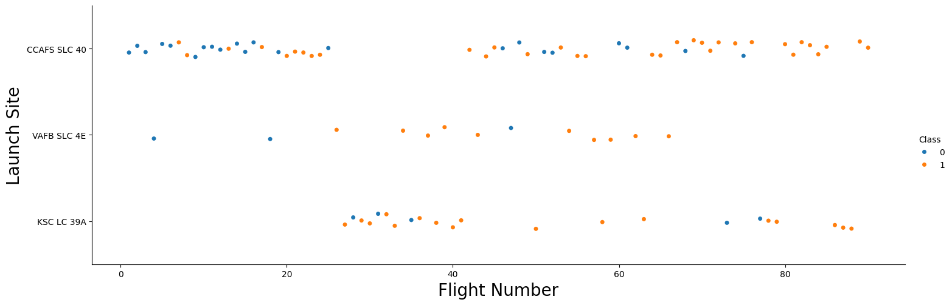
Flight Number vs. Launch Site
Explanation:
Over time, all launch sites have experienced both successful and failed first-stage landings, with a noticeable improvement in success rates. In the early stages, most launches resulted in failure, indicating that technological advancements and process improvements played a significant role in increasing reliability. Among the sites, CCAFS SLC 40 has conducted the highest number of launches overall. However, when evaluating relative success rates, VAFB SLC 4E appears to have a comparatively higher proportion of successful landings.

Slide 19
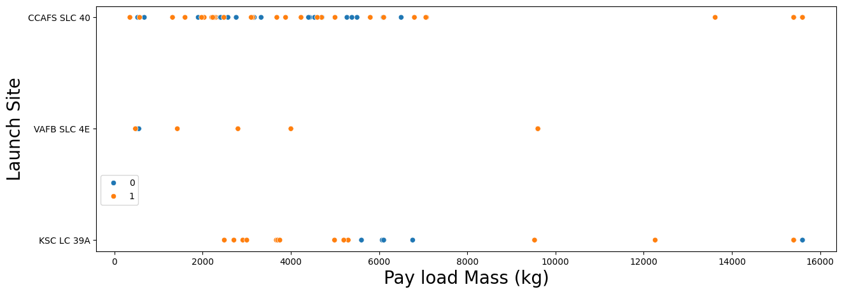
Payload vs. Launch Site
Explanation:
All launch sites have handled a wide range of payload weights, from light to heavy payloads. In the early stages, most flights carried lighter payloads, which also corresponded with a higher failure rate in landings. This trend suggests that advancements in technology and operational strategies have contributed to an improved success rate, even for missions carrying heavier payloads.

Slide 20
Success Rate vs. Orbit Type
Explanation:
Certain orbit types, such as ES-L1, SSO, HEO, and GEO, have consistently demonstrated high success rates in first-stage landings. In contrast, orbits like GTO show more varied outcomes, indicating that some orbit types may present additional operational or technological challenges. Additionally, the SO orbit type has only one recorded launch, making it difficult to draw meaningful conclusions from the limited data available.

Slide 21
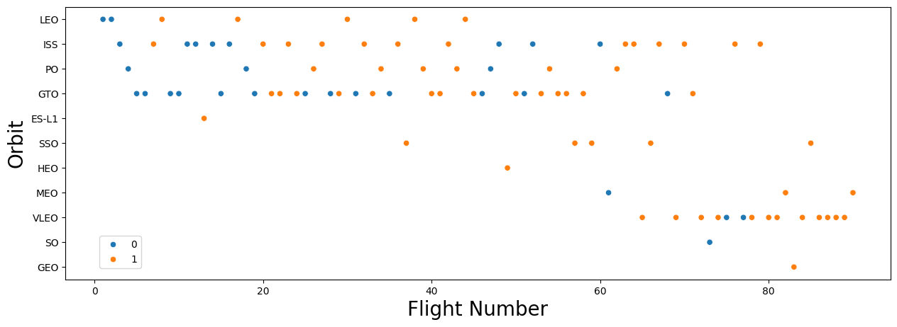
Flight Number vs. Orbit Type
Explanation:
Various orbit types are represented across different flight numbers, though some orbits were only attempted in later missions. As flight numbers increase, there is a clear trend of improved landing success, suggesting that experience and continuous advancements in technology have contributed to better outcomes over time.

Slide 22
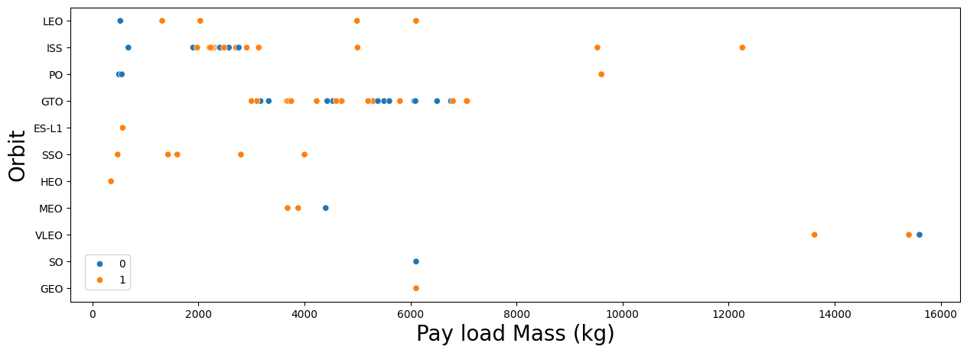
Payload vs. Orbit Type
Explanation:
Different orbits accommodate a wide range of payload masses, though some, such as SSO, MEO, HEO, and GEO, generally fall within a lower range. Orbits with more constrained payload ranges tend to have higher landing success rates. While payload mass alone does not directly determine mission success, its relationship with orbit type suggests a meaningful correlation.

Slide 23
Launch Success Yearly Trend
Explanation:
The yearly trend highlights a steady improvement in first-stage landing reliability, evolving from early challenges to higher success rates over time. Since 2016, SpaceX has achieved continuous year-over-year progress, with a slight setback in 2018 before continuing its upward trajectory.

Slide 24
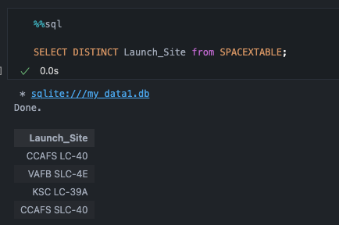
All Launch Site Names
Explanation:
Used Distinct key word to show only unique launch site name from the SpaceX Data

Slide 25
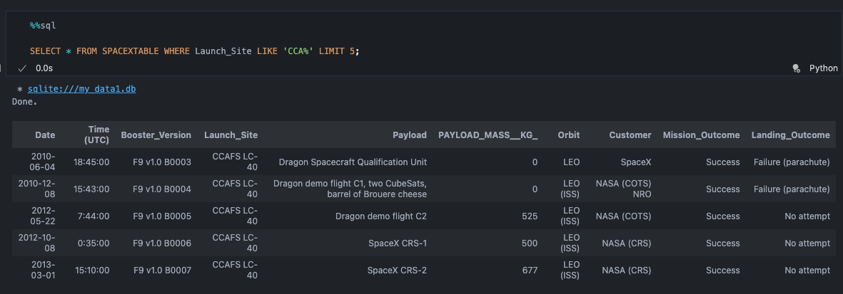
Launch Site Names Begin with 'CCA'
Explanation:
Used query above to display five record where launch sites begin with ‘CCA’

Slide 26
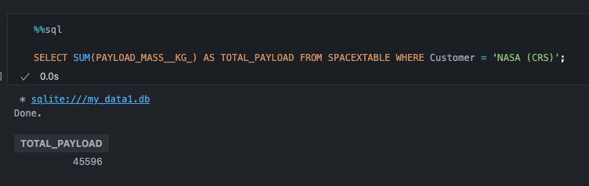
Total Payload Mass
Explanation:
Used query above to calculate the total payload carried by boosters from NASA (CRS) is 45,596 kg

Slide 27
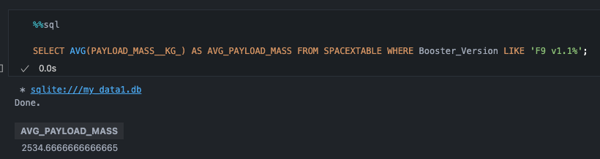
Average Payload Mass by F9 v1.1
Explanation:
Used query above to calculated the average payload mass caried by booster version F9 v1.1 is 2,534.6 kg

Slide 28
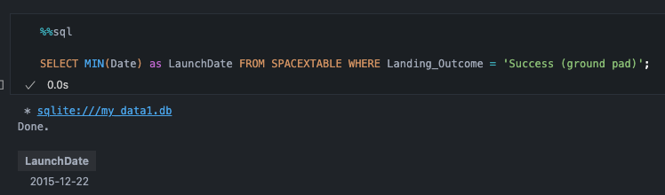
First Successful Ground Landing Date
Explanation:
Used query above to observe that the first successful landing outcome on ground pad occurred on 22 December 2015

Slide 29
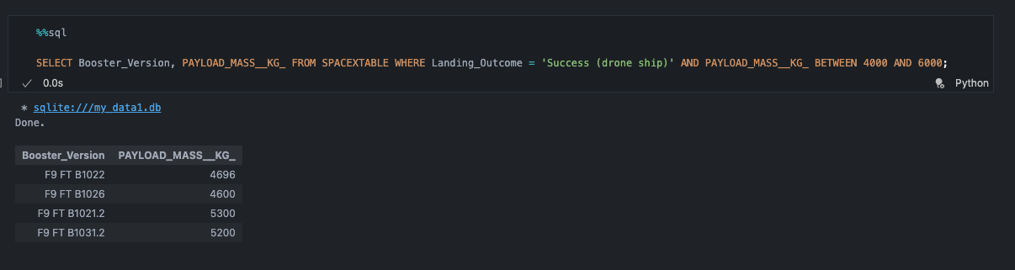
Successful Drone Ship Landing with Payload between 4000 and 6000
Explanation:
Used query above to filter which boosters have successfully landed on drone ship and had payload mass greater than 4000 but less than 6000

Slide 30
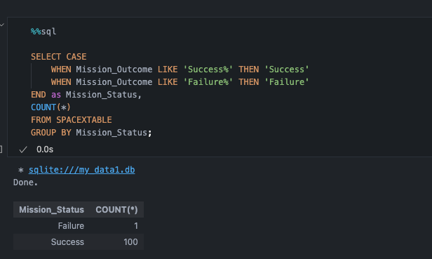
Total Number of Successful and Failure Mission Outcomes
Explanation:
Used wildcard and where clause on query to observe total number of successful and failure mission outcomes

Slide 31
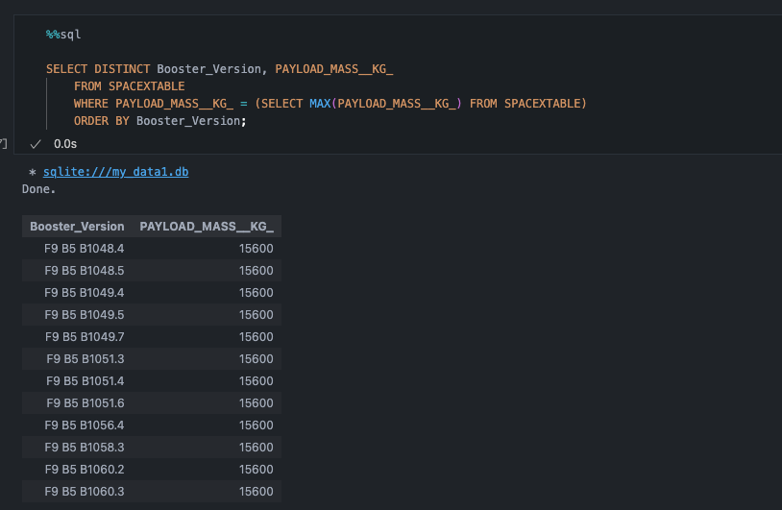
Boosters Carried Maximum Payload
Explanation:
Determined the boosters that carried the maximum payload using subquery in where clause and max function

Slide 32
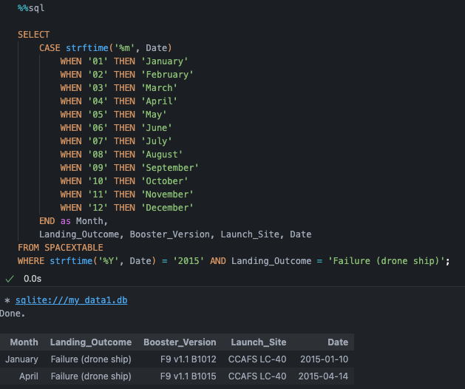
2015 Launch Records
Explanation:
Used combination of WHERE, AND, CASE, and Wild Card to filter for failed landing outcomes in drone ship, their booster versions, and launch site names for year 2015

Slide 33
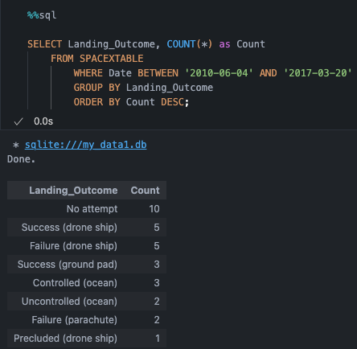
Rank Landing Outcomes Between 2010-06-04 and 2017-03-20
Explanation:
Used WHERE to filter between 2010-06-04 to 2010-03-20, GROUP BY outcome to group landing outcome and ORDER BY clause to order the group landing outcome in DESC order

Slide 34

Section 3

Slide 35
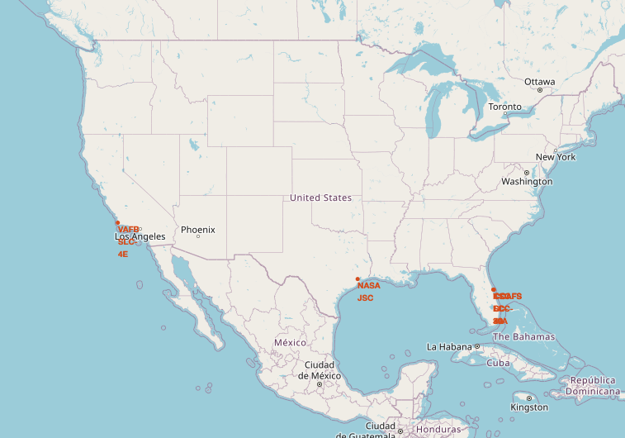
Launch Site Locations
Explanation:
SpaceX launch sites located in the United States of America coasts that near coastal regions in Floria and California to reduce catastrophic failures affecting human activities

Slide 36
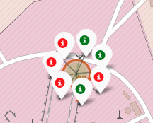
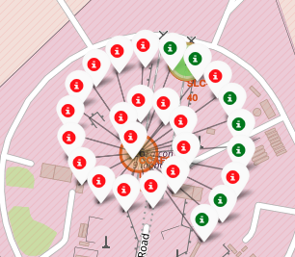
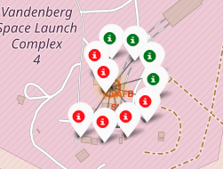
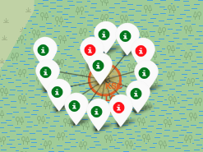
Launch Sites Outcomes
CCAFS SLC-40
CCAFS LC-40
VAFB SLC-4E
California
Legend:
Successful Launches
Failures Launches
KSC LC-39A
Florida

Slide 37
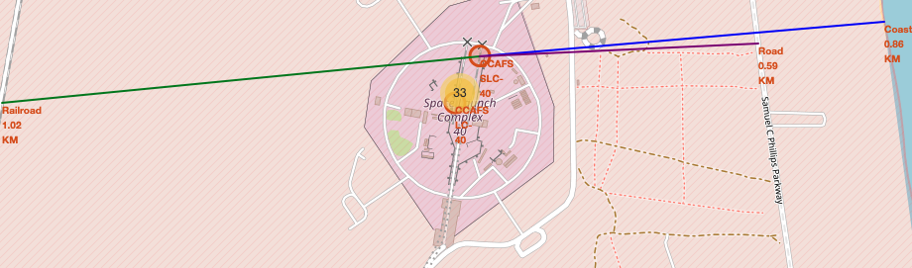
Proximate Launch Sites to Notable Locations
Distance:
Railway = 1.02 KM
Roadway = 0.59 KM
Coast = 0.86 KM

Slide 38

Section 4

Slide 39
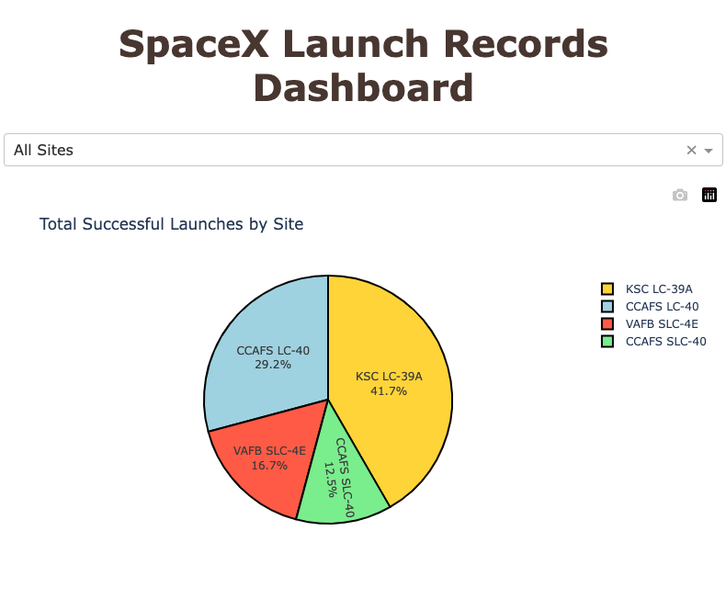
Success Percentage by each launch site
Explanation:
KSC LC-39A had the most successful launches, followed by CCAFS LC-40.
VAFB SLC-4E and CCAFS SLC-40 is the lowest launch success.

Slide 40
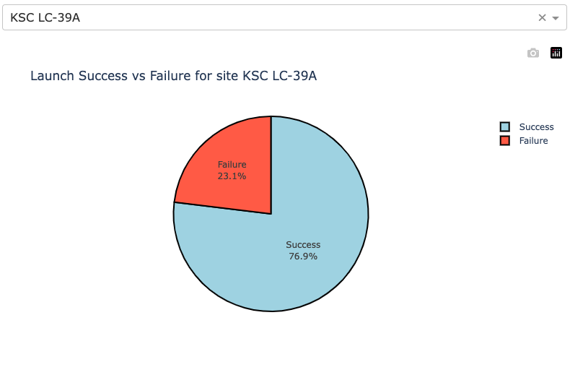
Highest Launch Success Ratio
Explanation:
KSC LC-39A achieved a 76.9% success rate which is the highest ratio of successful landings compare to other site

Slide 41
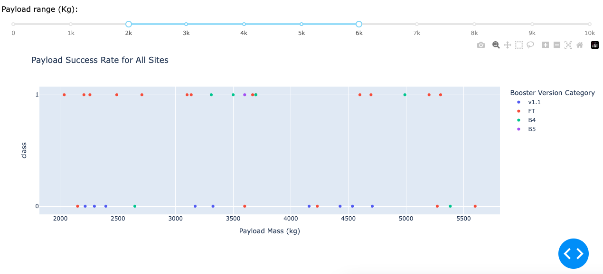
Payload Mass Range
Explanation:
Payload range between 2,000 and 6,000 kg shows that v1.1 boosters performed the worst but we can see that FT boosters had the best success rate, followed by B4.

Slide 42

Section 5

Slide 43
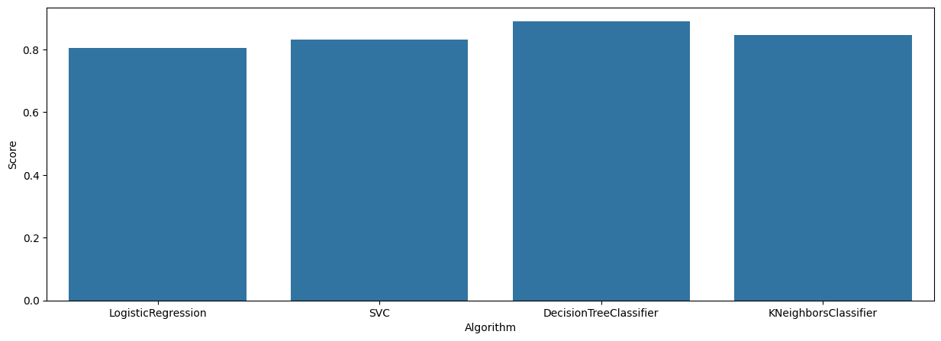
Classification Accuracy
Explanation:
Based on algorithms comparison, Decision tree classifier is the model with the highest classification accuracy

Slide 44
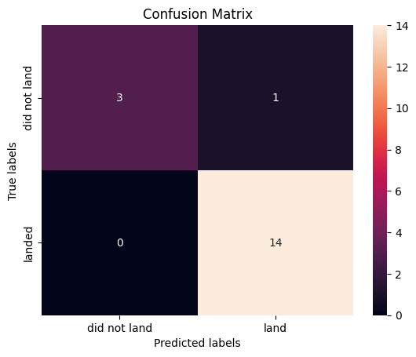
Confusion Matrix
Explanation:
The confusion matrix for the decision tree classifier indicates its ability to differentiate between successful and failed landings. It correctly predicted 14 successful landings (true positives) and 3 failed landings (true negatives). However, one failed landing was misclassified as a success (false positive), while no successful landings were incorrectly predicted as failures (false negatives). The main issue with the model is the occurrence of false positives, where unsuccessful landings are mistakenly classified as successful.

Slide 45
Conclusions
Launch success rates have steadily improved over time, indicating continuous technological and operational advancements.
Higher launch frequency at a site correlates with greater overall success rates.
The most successful orbits include ES-L1, GEO, HEO, SSO, and VLEO.KSC LC-39A recorded the highest number of successful launches, followed closely by CCAFS LC-40.
Among the predictive models tested, the Decision Tree Classifier demonstrated the best performance with high accuracy, precision, and recall, making it the most suitable model for this task.

Slide 46
Appendix
Notebook:
https://github.com/Fernando-Lim/data-science-capstone
Charts:
https://github.com/Fernando-Lim/data-science-capstone/tree/main/flowcharts
SpaceX API:
https://github.com/r-spacex/SpaceX-API/tree/master/docs#rspacex-api-docs
Wikipedia:
https://en.wikipedia.org/w/index.php?title=List_of_Falcon_9_and_Falcon_Heavy_launches&oldid=1027686922

Slide 47


